Slide 1

Probabilistic Supervised Classification
Yuxiao Xiong

Slide 2


Dataset
Gender Recognition by Voice
20 attributes: acoustic properties of the voice and speech
3,168 observations

Slide 3
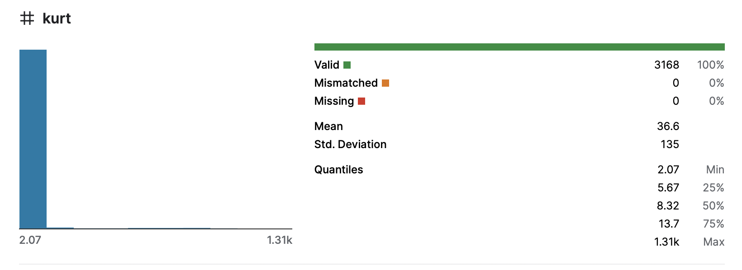
Pre-processing
Clean ✓
No empty values ✓
Normalization (Pandas, Sklearn)
Discretization (for Tree-Augmented Naïve Bayes)
Notes:
While the values of most attributes are between 0 and 2, kurt takes value from 2 to 1.31k.--> normalization

Slide 4
Classifiers & Metaclassifiers
Classifiers
Logistic Regression
Metaclassifiers
Bagging with Multilayer Perceptron
Tree-Augmented Naïve Bayes
Fisher´s Linear Discriminant Analysis
Random Forest
Boosting with RLog
Fusion with Majority vote (k-NN, RIPPER, Support Vector Machine, C4.5 tree and Logistic Regression)
Testing option: Cross-Validation with 10 folds
Notes:
Bagging: make sense with unstacle classifier

Slide 5
Feature Subset Selection
 | Attribute Evaluator | Method
Univariate | Gain Ratio (threshold = 0.1) | Ranker
Multivariate | CFS | Ranker
Wrapper | Wrapper | BestFirst
Metaclassifiers: only on univariate subset.

Slide 6
Relevant and redundant attributes
Relevant
Meanfun
Redundant
meanfreq
IQR
Q75
skew
centroid

Slide 7
Accuracy
 | Rlog | TAN | FLDA
All variables | 97.096 % | 97.222% | 96.843%
Univariate | 97.033% | 97.790% | 96.181%
Multivariate | 96.559% | 96.654% | 96.117%
Wrapper | 97.285% | 98.043% | 96.970%

Slide 8
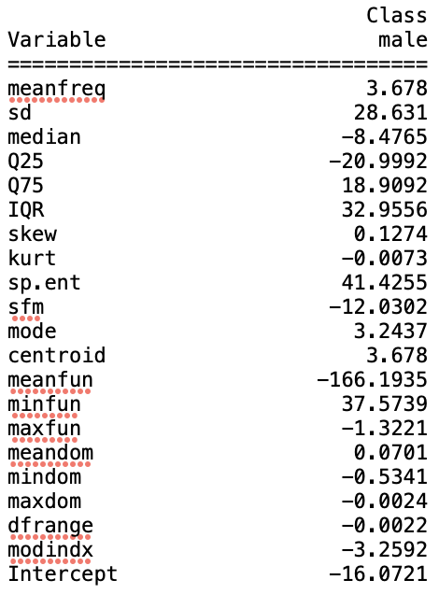
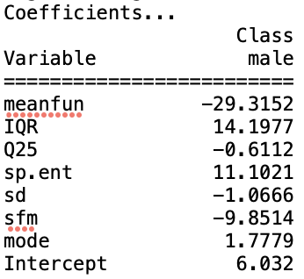
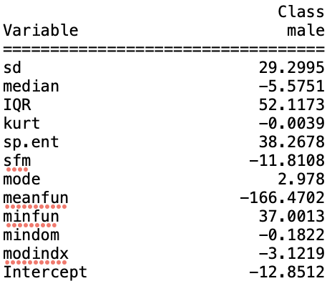
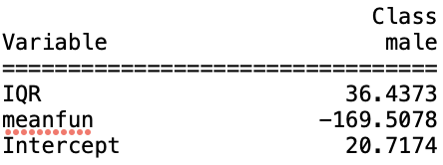
RLog
Univariate
Wrapper
Unstable β
All variables
Multivariate

Slide 9
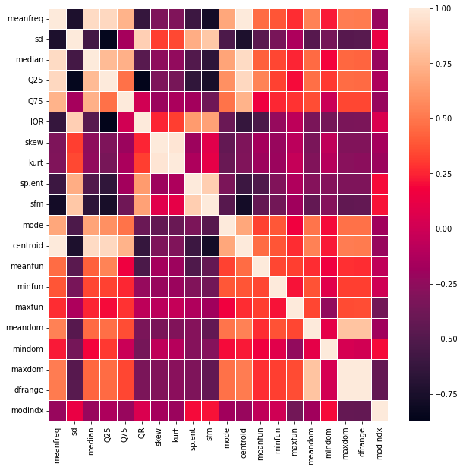
RLog
Correlated
corr>0.95→Remove
kurt centroid dfrange

Slide 10
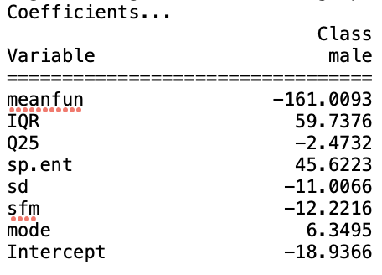
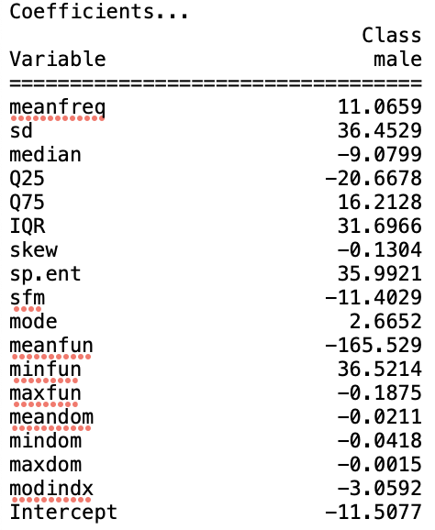
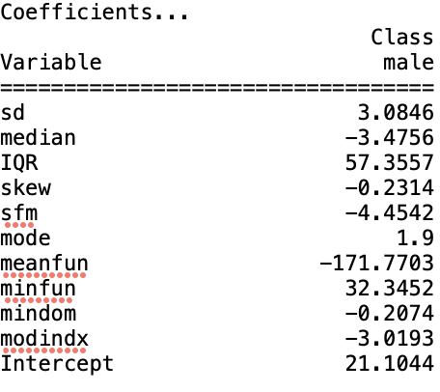
RLog
-29
14
Univariate
Wrapper
All variables
Multivariate

Slide 11
RLog
 | Original | New
All variables | 97.096 % | 97.123%
Univariate | 97.033% | 97.033%
Multivariate | 96.559% | 96.559%
Wrapper | 97.285% | 97.317% (1 new attribute chosen and 2 original attributes discarded)
Notes:
Insteresting thing: univariate changes in coefficients but the dataset and the accuracy maintains the same.

Slide 12
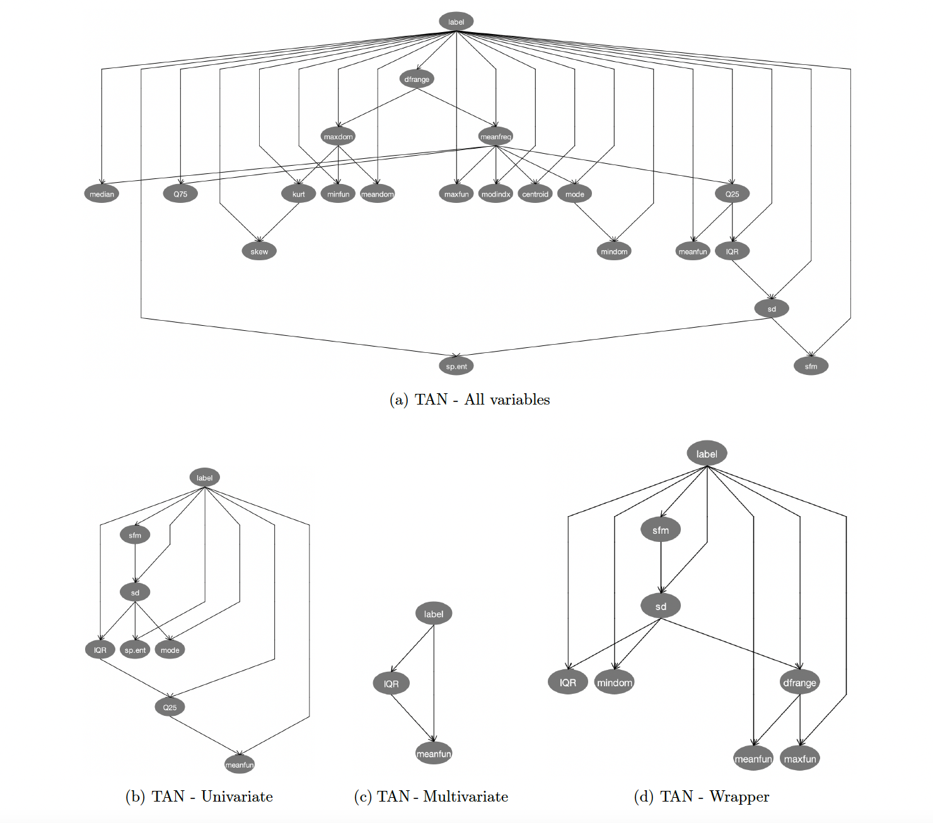
TAN

Slide 13
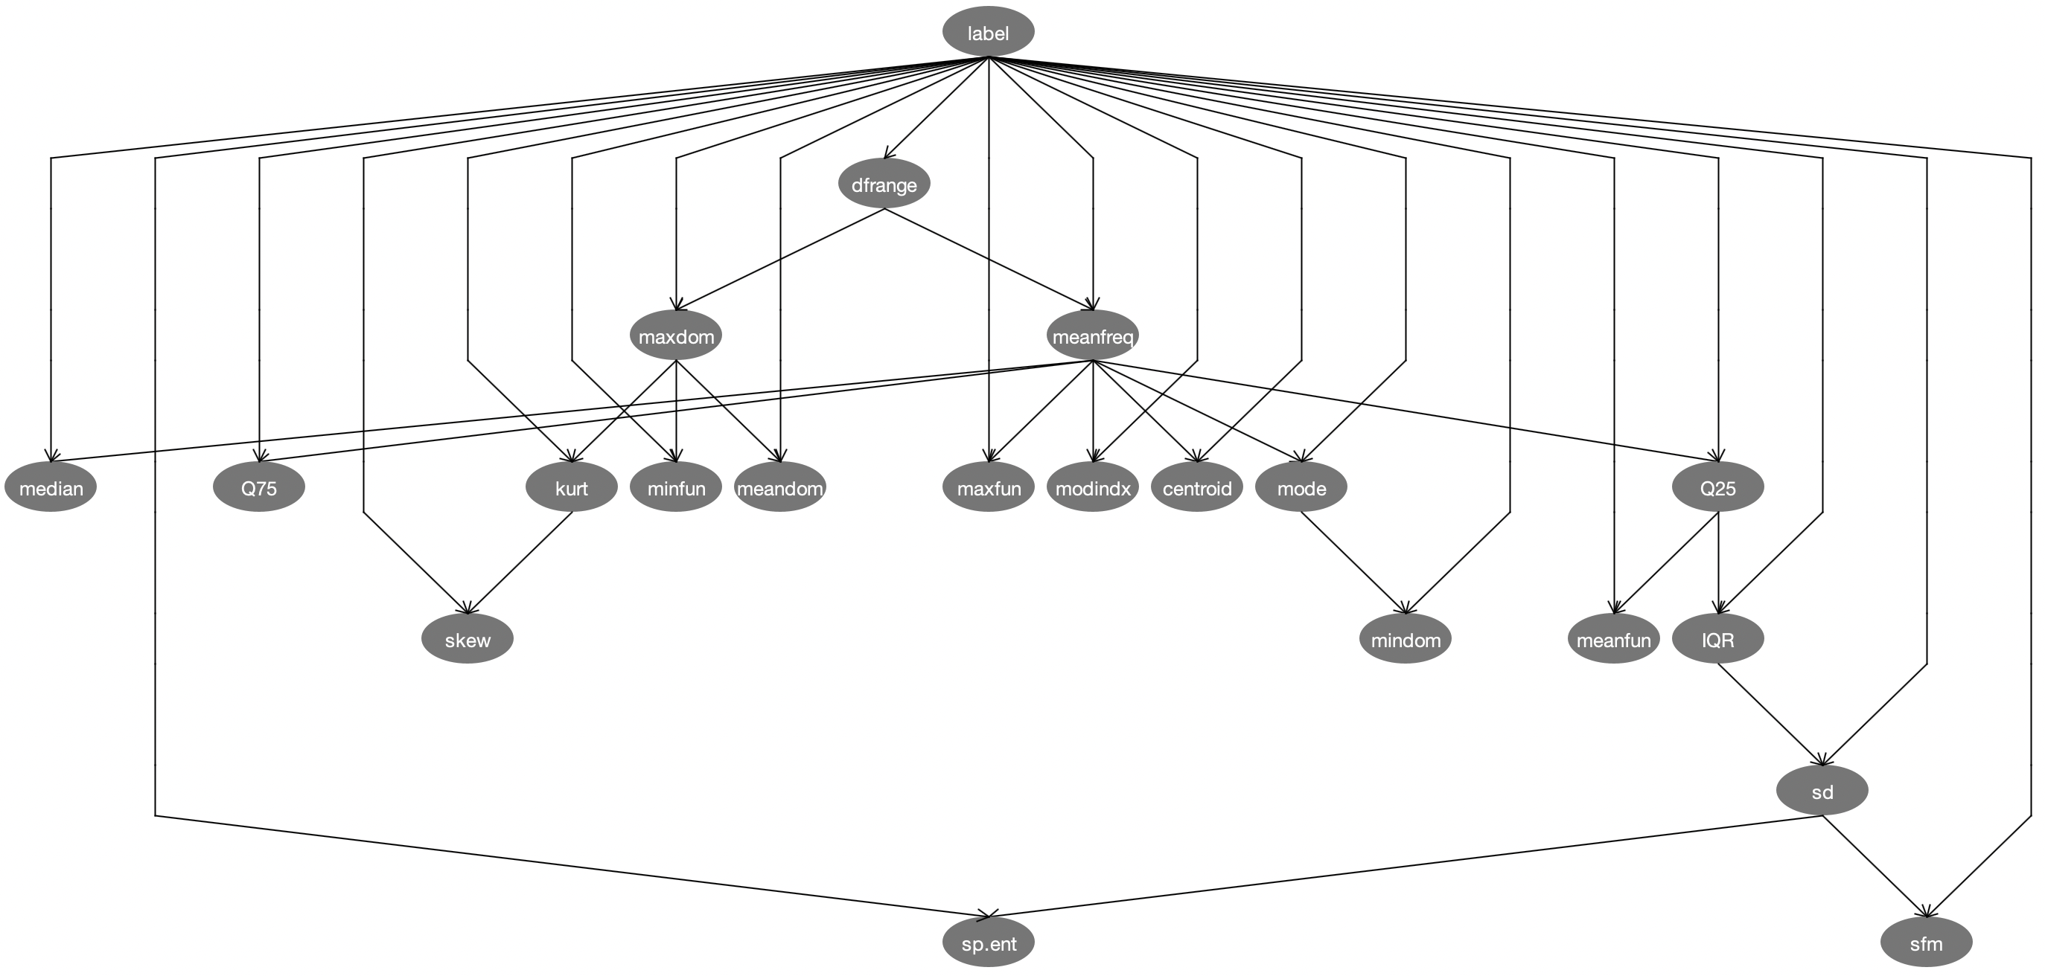
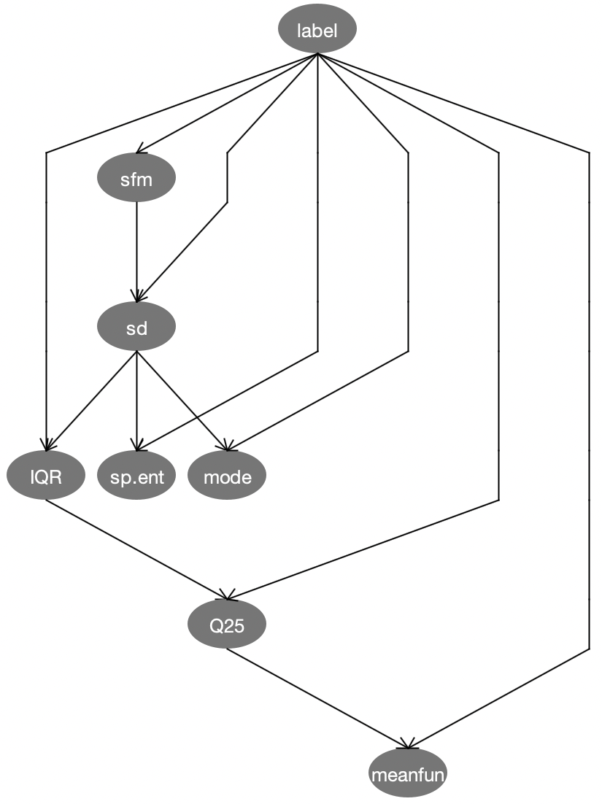
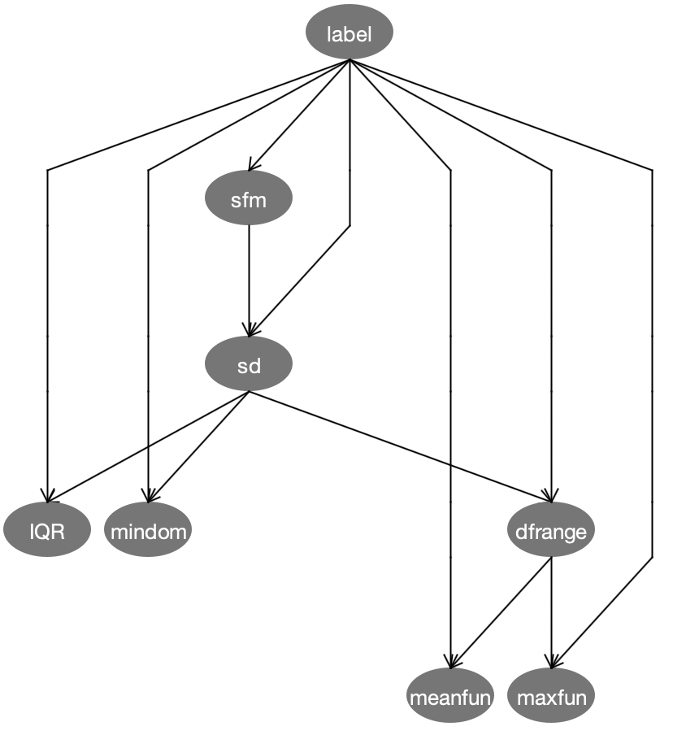

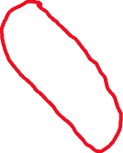

TAN
All
Univariate
Wrapper

Slide 14
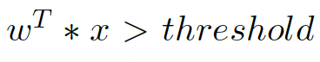
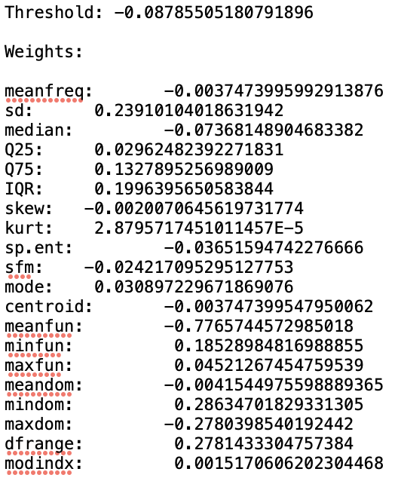
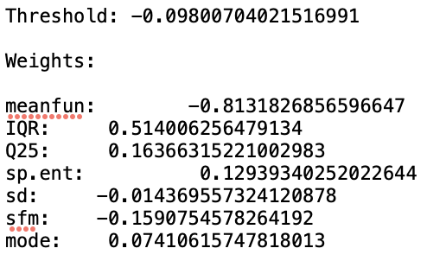
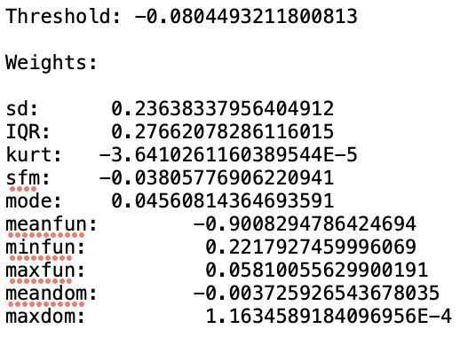
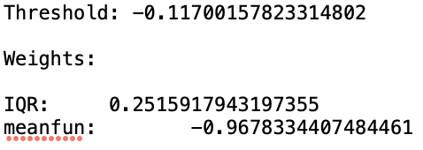
FLDA
male class
Univariate
Wrapper
All variables
Multivariate
Notes:
Accuracy decreases when discarding attributes

Slide 15
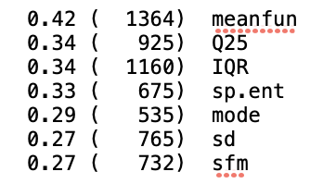
Metaclassifiers
Bagging with NN
Bossting with Rlog
Random Forest
Vote: 97.790%
KNN(98.296%), RIPPER(97.096%), SVM(97.191%), C4.5(97.191%), RLog(97.033%)
Same performance as the original ones

Slide 16
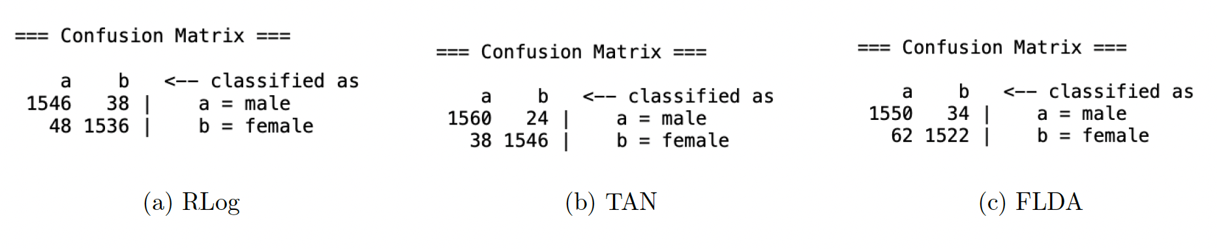
Confusion Matrix
Notes:
Balanced: why not f-score

Slide 17
Conclusion
TAN for numeric variables
Future work: balance between correlation and stable β for RLog
meanfun & IQR

